Slide 1


Uttam Kumar Dey Data Science and Machine Learning Trainer, Software Developer, Security and Big Data Analysis
Md. Mahmodul Hasan
Data Science and Machine Learning Trainer

Slide 2

Machine
Learning

Slide 3
Artificial Intelligence

Slide 4
Obvious question
What is Intelligence?
Intelligence is the ability to understand and learn things. - Essential English Dictionary
“Intelligence is the capacity to act purposefully with the environment” – David Weshlar
“Intelligence is the general mental adaptability to new problems and conditions” - W. Stern
Learning? - Any relatively permanent change in behavior which occurs as a result of experience or practice.

Slide 5
Obvious question
What is AI?
Programs that behave externally like humans?
Programs that operate internally as humans do?
Computational systems that behave intelligently?
Rational behaviour?

Slide 6
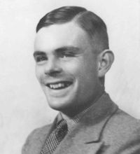
Turing Test
Human beings are intelligent
To be called intelligent, a machine must produce responses that are indistinguishable from those of a human
Alan Turing

Slide 7
Does AI have applications?
Autonomous planning and scheduling of tasks aboard a spacecraft
Beating Gary Kasparov in a chess match
Steering a driver-less car
Understanding language
Robotic assistants in surgery
Monitoring trade in the stock market to see if insider trading is going on

Slide 8
A rich history
Philosophy
Mathematics
Economics
Neuroscience
Psychology
Control Theory
John McCarthy- coined the term- 1950’s

Slide 9
Philosophy
Dealt with questions like:
Can formal rules be used to draw valid conclusions?
Where does knowledge come from? How does it lead to action?
David Hume proposed the principle of induction (later)
Aristotle-
Given the end to achieve
Consider by what means to achieve it
Consider how the above will be achieved …till you reach the first cause
Last in the order of analysis = First in the order of action
If you reach an impossibility, abandon search

Slide 10
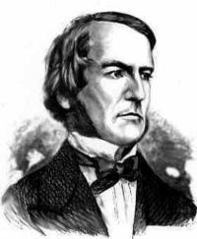
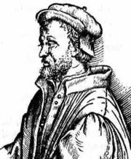
Mathematics
Boolean Logic(mid 1800’s)
Intractability (1960’s)
Polynomial Vs Exponential growth
Intelligent behaviour = tractable
subproblems, not large intractable
problems.
Probability
Gerolamo Cardano(1500’s) - probability in terms of outcomes of gambling events
George Boole
Cardano

Slide 11
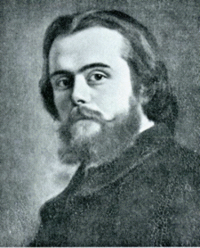
Economics
How do we make decisions so as to maximize payoff?
How do we do this when the payoff may be far in the future?
Concept of utility (early 1900’s)
Game Theory (mid 1900’s)
Leon Walras

Slide 12
Neuroscience
Study of the nervous system, esp. brain
A collection of simple cells can lead to thought and action
Cycle time: Human brain- microseconds
Computers- nanoseconds
The brain is still 100,000 times faster

Slide 13
Psychology
Behaviourism- stimulus leads to response
Cognitive science
Computer models can be used to understand the psychology of memory, language and thinking
The brain is now thought of in terms of computer science constructs like I/O units, and processing center

Slide 14
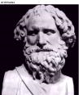
Control Theory
Ctesibius of Alexandria- water clock with a regulator
Purposeful behavior as arising from a regulatory mechanism to minimize the difference between goal state and current state (“error”)

Slide 15
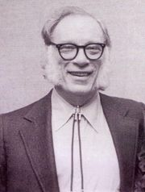
Does AI meet EE?
Robotics- the science and technology of robots, their design, manufacture, and application.
Liar! (1941)
Isaac Asimov

Slide 16
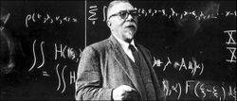
Mechatronics- mechanics, electronics and computing which, combined, make possible the generation of simpler, more economical, reliable and versatile systems.
Norbert Wiener
Cybernetics- the study of communication and control, typically involving regulatory feedback, in living organisms, in machines, and in combinations of the two.

Slide 17
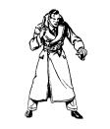
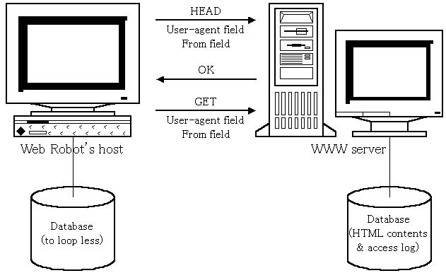
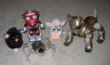
An Agent
‘Anything’ that can gather information about its environment and take action based on that information.

Slide 18
The Environment
What all do we need to specify?
The action space
The percept space
The environment as a string of mappings from the action space to the percept space

Slide 19
The World Model
Perception function
World dynamics / State transition function
Utility function- how does the agent know what constitutes “good” or “bad” behaviour

Slide 20
What is Rationality?
Goal
Information / Knowledge
The purpose of action is to reach the goal, given the information/knowledge possessed by the agent
Is not omniscience
The notion of rationality does not necessarily include success of the actions chosen

Slide 21
Environments
Accessible/Inaccessible
Deterministic/Non-deterministic
Static/Dynamic
Discrete/Continuous
E.g. Driving a car, a game of Chinese-checkers

Slide 22
Agents
Reactive agents
No memory
Agents with memory

Slide 23
Intelligent Agent

Slide 24
Instructional Objective
Define an agent
Define an Intelligent agent
Define a Rational agent
Discuss different types of environment
Explain classes of intelligent agents
Applications of Intelligent agent

Slide 25
Agents
An agent is anything that can be viewed as perceiving its environment through sensors and acting upon that environment through effectors.
A human agent has eyes, ears, and other for sensors, and hands, legs, mouth, and other body parts for effectors.
A robotic agent substitutes cameras and infrared range finders for the sensors and various motors for the effectors.

Slide 26
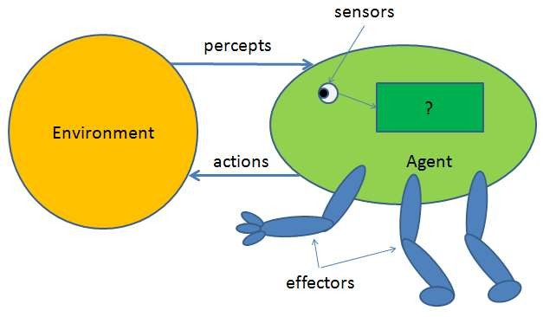
Agent and Environment

Slide 27
Agents
Operate in an environment
Perceives its environment through sensors
Acts upon its environment through actuators/effectors
Have goals

Slide 28
Sensors & Effectors
An agent Perceives its environment through sensors.
The complete set of inputs at a given time is called percept.
The current percept, or a sequence of percepts can influence the actions of an agent.

Slide 29
Sensors & Effectors
It can change the environment through effectors.
An operation involving an actuator is called an action.
Actions can be grouped in to action sequences.
So an agent program implement mapping from percept sequences to actions

Slide 30
Agents
Autonomous Agent: Decide autonomously which action to take in the current situation to maximize progress towards its goals.
Performance measure: An objective criterion for success of an agent's behavior.
E.g., performance measure of a vacuum- cleaner agent could be amount of dirt cleaned up, amount of time taken, amount of electricity consumed, amount of noise generated, etc.

Slide 31
Examples of agents
· Humans
eyes, ears, skin, taste buds, etc. for Sensors.
hands, fingers, legs, mouth for effectors.
· Robots
camera, infrared, bumper, etc. for sensors. grippers, wheels, lights, speakers, effectors.
etc. for

Slide 32
Structure of agents
A simple agent program can be defined mathematically as an agent function which maps every possible precepts sequence to a possible action the agent can perform.
· F: p*-> A
the term percept is use to the agent's perceptional inputs at any given instant.

Slide 33
Intelligent agents
Fundamental faculties of intelligence Acting
Sensing
Understanding, Reasoning, learning
In order to act you must sense. Blind actions is not
a characterization of intelligence.
Robotics: sensing and acting. Understanding not necessary.
Sensing needs understanding to be useful.

Slide 34
Intelligent Agents
· Intelligent Agent: must sense, must act,
must be autonomous(to some extent) must be rational.

Slide 35
Rational Agent
AI is about building rational agents.
An agent is something that perceives and acts.
A rational agent always does the right thing.
What are the functionalities (goals)? What are the components?
How do we build them?

Slide 36
Rationality
· Perfect Rationality:
Assumes that the rational agent knows all and will take the action that maximize the utility.
Human beings do not satisfy this definition of rationality.

Slide 37
Agent Environment
Environments in which agents operate can be defined in different ways.
It is helpful to view the following definitions as referring to the way the environment appears from the point of view of the agent itself.

Slide 38
Environment: Observability
Fully Observable:
relevant to the action being considered is
All of the environment
observable. Such environments are convenient, since the agent is freed from the task of keeping track of changes in the environment.
Partially Observable: The relevant features of the environment are only partially observable.
Example: Fully obs: Chess; Partially obs: Poker

Slide 39
Environment: Determinism
· Deterministic:
The next state of the
environment is completely described by the current state and the agent’s action. e.g. Image Analysis
· Stochastic:
If an element of interference or
uncertainty occurs then the environment is stochastic. A partially observable environment will appear to be stochastic to the agent. e.g. ludo
· Strategic: Environment state wholly determined by the preceding state and the actions of multiple agents is called strategic. e.g. Chess

Slide 40
Environment: Episodicity
· Episodic/Sequential:
An Episodic Environment means that subsequent episodes do not depend on what actions occurred in previous episodes.
In a Sequential Environment, the agent engages in a series of connected episodes.

Slide 41
Environment: Dynamism
Static Environment: does not change from one sate to next while the agent is considering its course of action. The only changes to the environment as those caused by the agent itself.
Dynamic Environment: Changes over time independent of the actions of the agent-and thus if an agent does not respond in a timely manner, this counts as a choice to do nothing.

Slide 42
Environment: Continuity
· Discrete/Continuous: If the number of distinct percepts and actions is limited, the environment is discrete, otherwise it is continuous.

Slide 43
Classes of Intelligent Agents
· Intelligent agents are grouped in to five classes based on their degree of perceived intelligence and capability.
Simple reflex agents
Model based reflex agents
Goal based agents
Utility based agents
Learning agents

Slide 44
Simple reflex agents
Simple reflex agents act only on the basis of the current percept, ignoring the rest of the percept history. The agent function is based on the condition-action rule: if condition then action.
Succeeds when the environment is fully observable.
Some reflex agents can also contain information on their current state which allows them to disregard conditions.

Slide 45
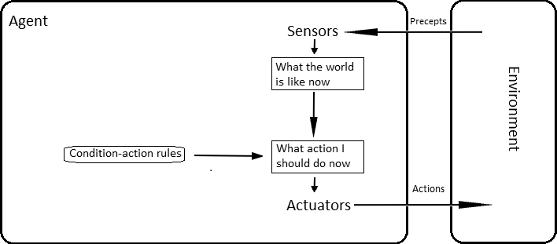
Simple reflex agents

Slide 46
Model based reflex agents
· A model-based agent can handle a partially observable environment.
· Its current maintaining
state is stored inside the some kind of structure
agent which
describes the part of the world which cannot be seen.
· This knowledge about "how the world evolves" is called a model of the world, hence the name "model-based agent".

Slide 47
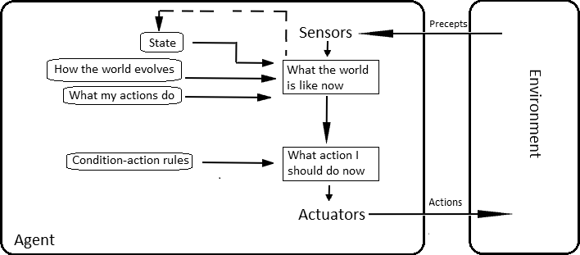
Model based reflex agents

Slide 48
Goal based agents
Goal-based agents further expand on the capabilities of the model-based agents, by using "goal" information.
Goal information describes situations that are desirable. This allows the agent a way to choose among multiple possibilities, selecting the one which reaches a goal state.
Search and planning are the subfields of artificial intelligence devoted to finding action sequences that achieve the agent's goals.

Slide 49
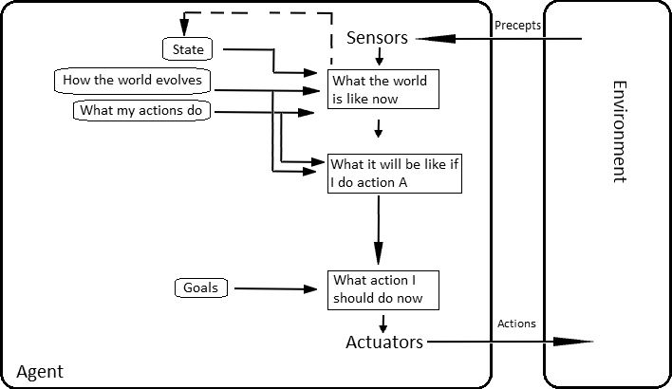
Goal based agents

Slide 50
Utility based agents
Goal-based agents only distinguish between goal states and non-goal states.
It is possible to define a measure of how desirable a particular state is. This measure can be obtained through the use of a utility function which maps a state to a measure of the utility of the state.
· A more general performance measure allow a comparison of different world
should states
according to exactly how happy they would make the agent. The term utility, can be used to describe how "happy" the agent is.

Slide 51
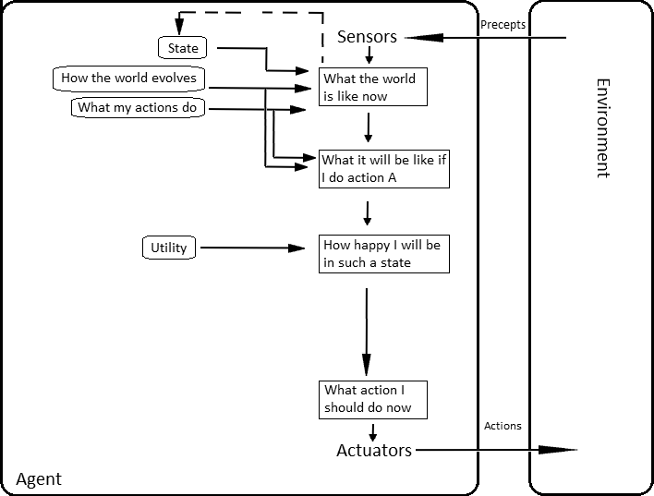
Utility based agents

Slide 52
Learning agents
Learning has an advantage that it allows the agents to initially operate in unknown environments and to become more competent than its initial knowledge alone might allow.
The most important distinction is between the "learning element", which is responsible for making improvements, and the "performance element", which is responsible for selecting external actions.
The learning element uses feedback from the "critic" on how the agent is doing and determines how the performance element should be modified to do better in the future.

Slide 53
Learning agents
· The last component of the learning agent is the "problem generator". It is responsible for suggesting actions that will lead to new and informative experiences.

Slide 54
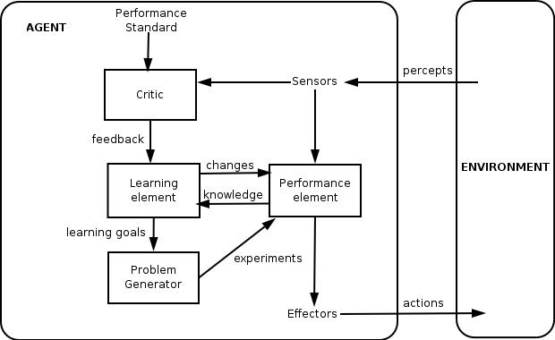
Learning agents

Slide 55
Applications of Intelligent Agents
· Intelligent agents are applied as automated online assistants, where they
function to perceive
the needs of to
customers in order
perform
individualized customer service.
· Use in smart phones in future.

Slide 56
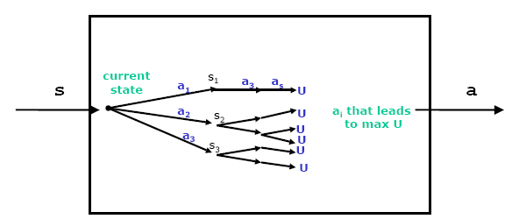
Planning
Planning a policy = considering the future consequences of actions to choose the best one

Slide 57
Learning
Incomplete information about the environment
A changing environment
Use the sequence of percepts to estimate the missing details
Hard for us to articulate the knowledge needed to build AI systems – e.g. try writing a program to recognize visual input like various types of flowers

Slide 58
What is Learning?
Herb Simon-
“Learning denotes changes in the system that are adaptive in the sense that they enable the system to do the tasks drawn from the same population more efficiently and more effectively the next time.”
But why do we believe we have the license to predict the future?

Slide 59
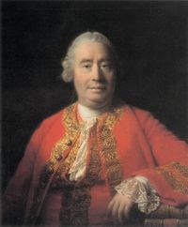
Induction
David Hume- Scottish philosopher, economist
All we can say, think, or predict about nature must come from prior experience
Bertrand Russell-
“If asked why we believe the sun will rise tomorrow, we shall naturally answer, ‘Because it has always risen everyday.’ ”
David Hume

Slide 60
Classifying Learning Problems
Supervised learning- Given a set of input/output pairs, learn to predict the output if faced with a new input.
Unsupervised Learning- Learning patterns in the input when no specific output values are supplied.
Reinforcement Learning- Learn to interact with the world from the reinforcement you get.

Slide 61
Functions
Given a sample set of inputs and corresponding outputs, find a function to express this relationship
Pronunciation= Function from letters to sound
Bowling= Function from target location (or trajectory?) to joint torques
Diagnosis= Function from lab results to disease categories

Slide 62
Data Analysis of Previous Years

Slide 63
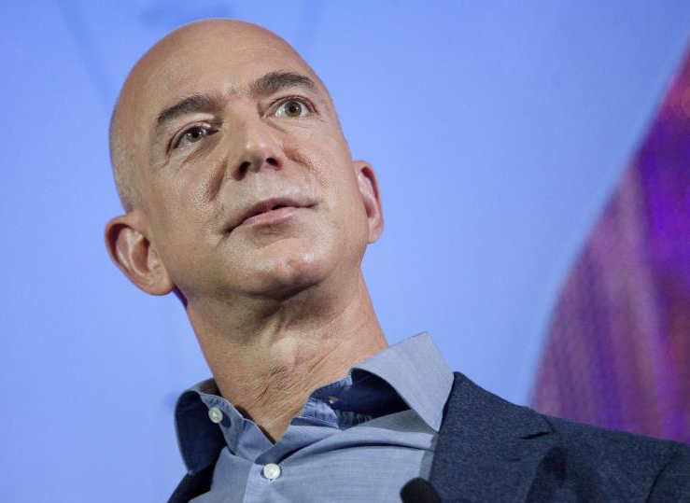

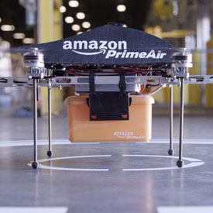
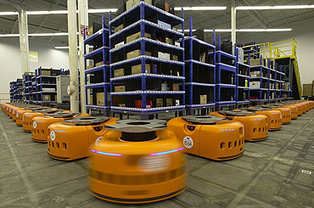
Last Year’s Disruptor

Slide 64





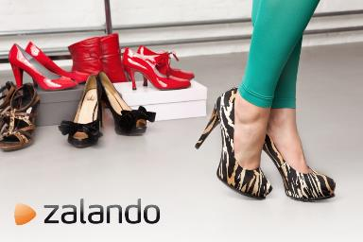
A Lookback to last few years
Cheap Capital
Technology
Cloud
Mobile
Uberization

Slide 65
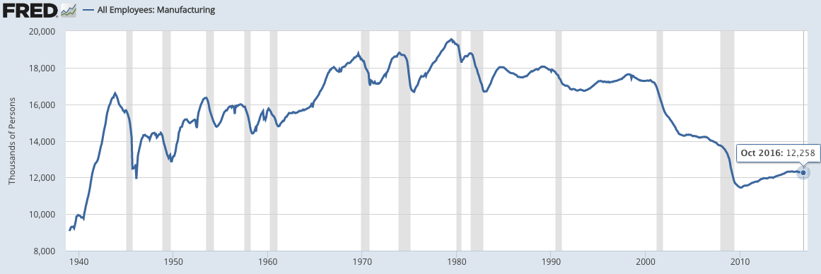
So Where Have all the Manufacturing Jobs Gone?
What Happened to Industrial Production During the Same Period?

Slide 66
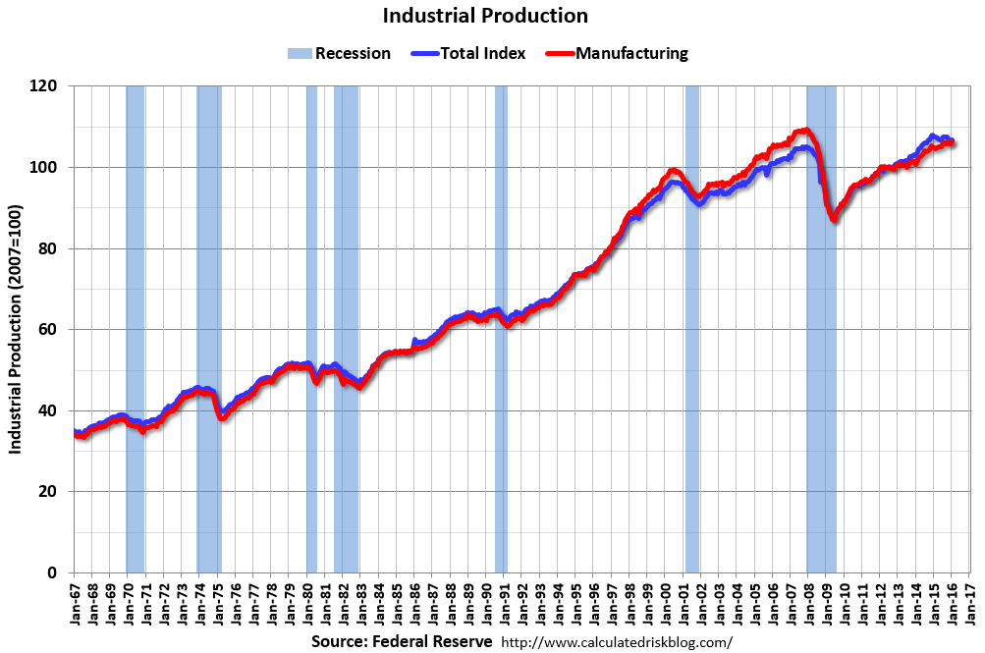
The Answer: It has Risen 250%

Slide 67
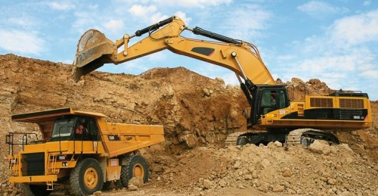
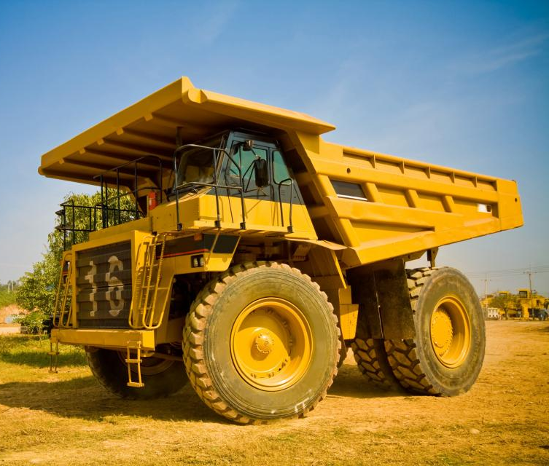
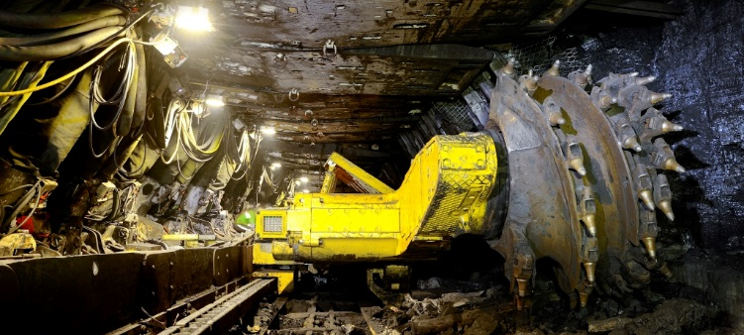
Who has the Highest Productivity Improvement?
Mining: 1 Person today does the work handled by 30 people, 40 years ago

Slide 68
4 Secular Changes
Utility Explodes
Digitization
Technology Enhance-ments
Capital Over Labor

Slide 69
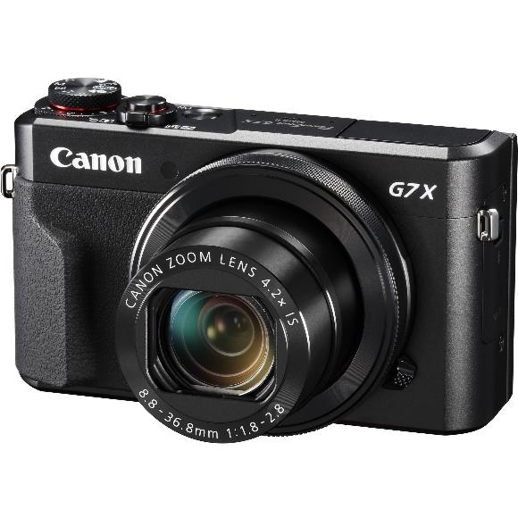

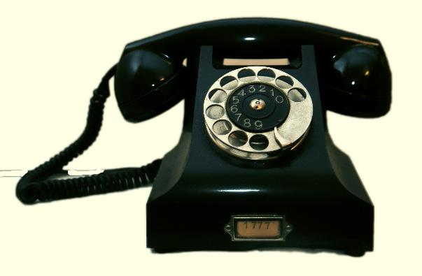
Utility
+
+

Slide 70
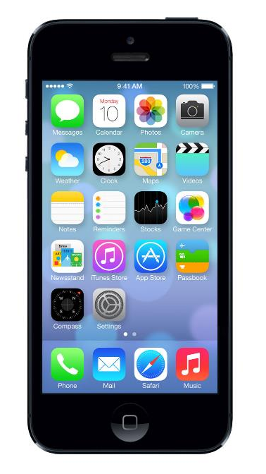
Utility

Slide 71
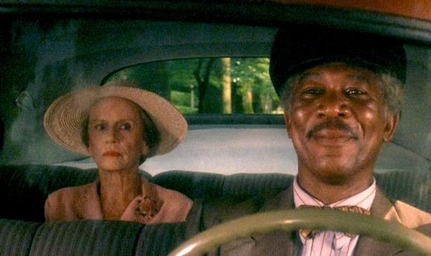

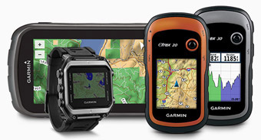
Utility
C
+
+

Slide 72
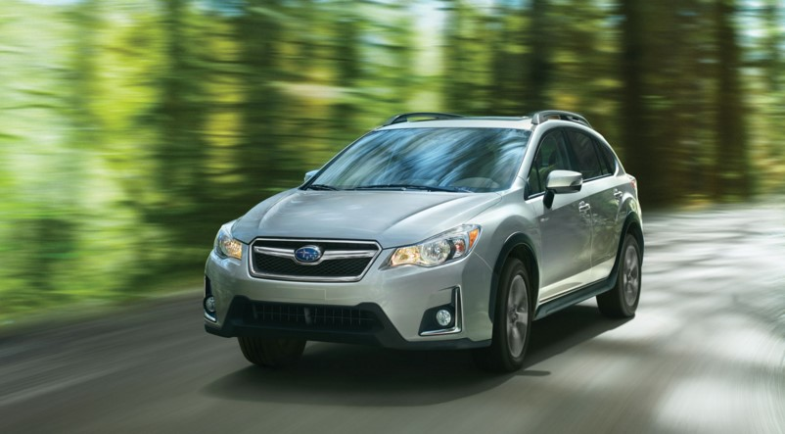
Utility

Slide 73

Digital Over Physical
Who has:
Cable or satellite TV
Internet
2+ cell phones
Premium TV (HBO)
Internet TV (Netflix)
XM Radio
$600 monthly in data
+

Slide 74
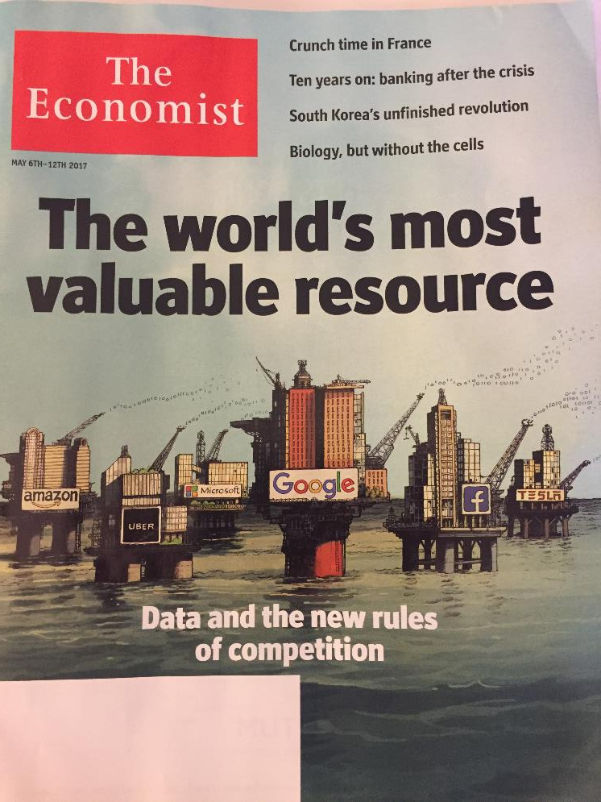

Slide 75
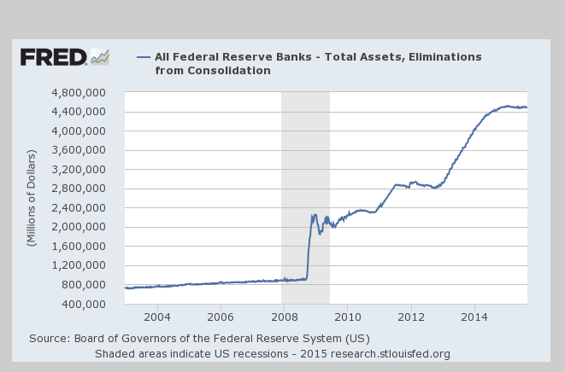
Substitute Capital for Labor

Slide 76
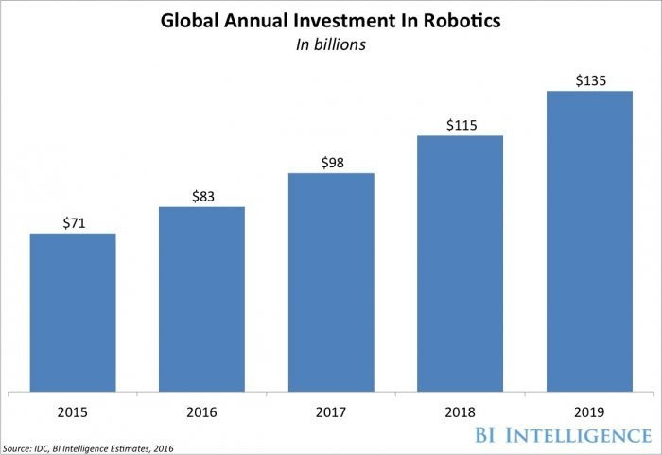
Investment in Robotics

Slide 77
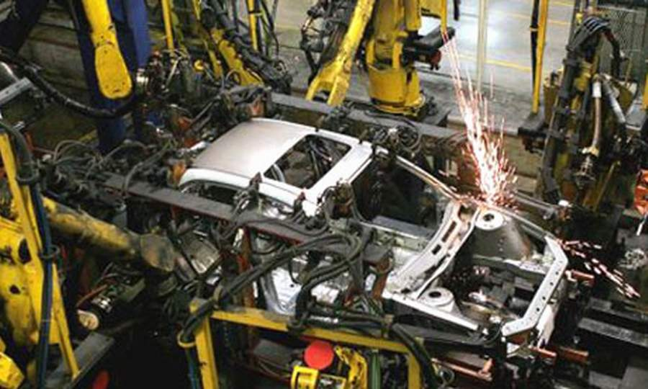
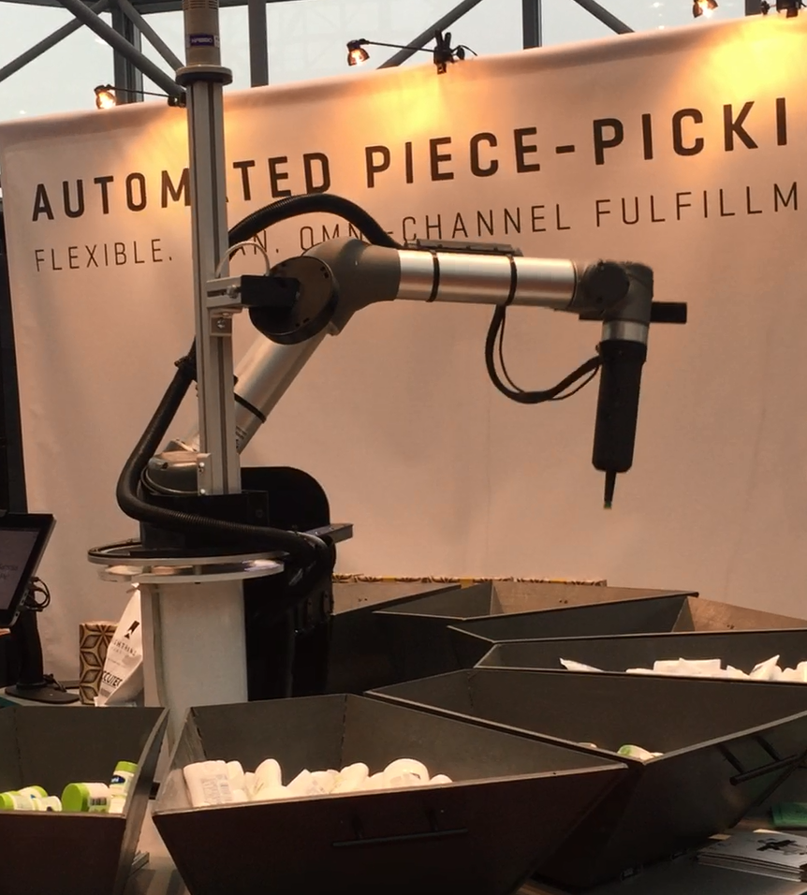
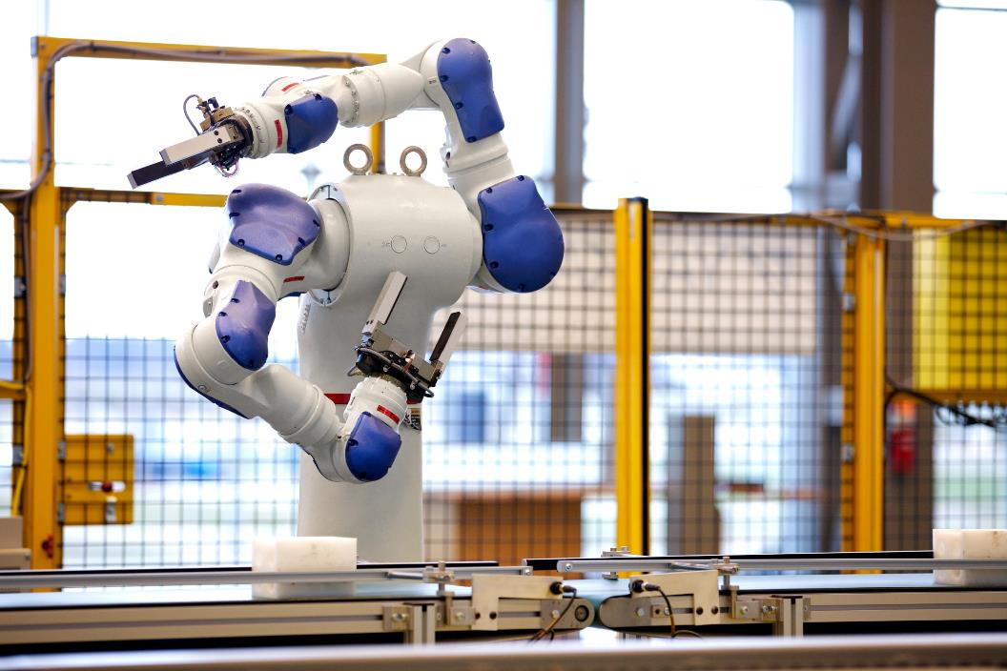

Slide 78
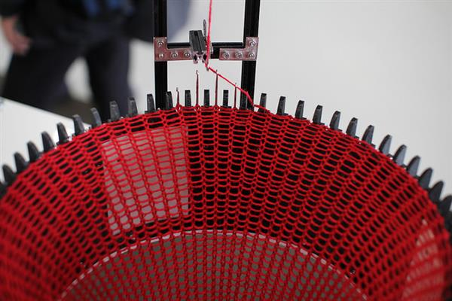
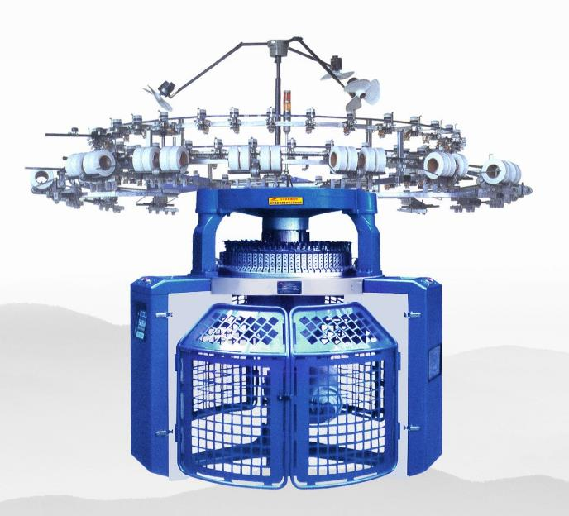
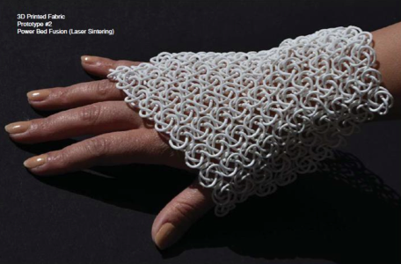
3D Knitting

Slide 79

Shima Seiki Sewing free knits

Slide 80

Technology Hits a Higher Gear

Slide 81

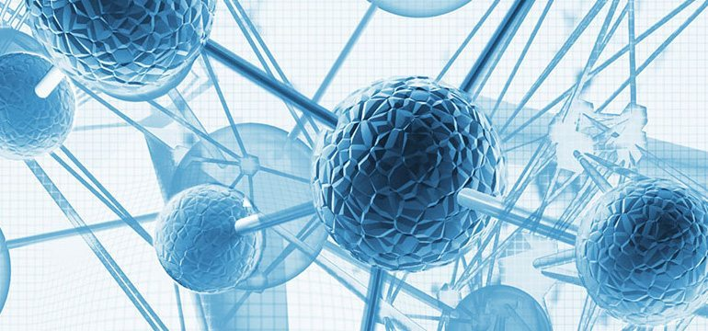
Material Science

Slide 82
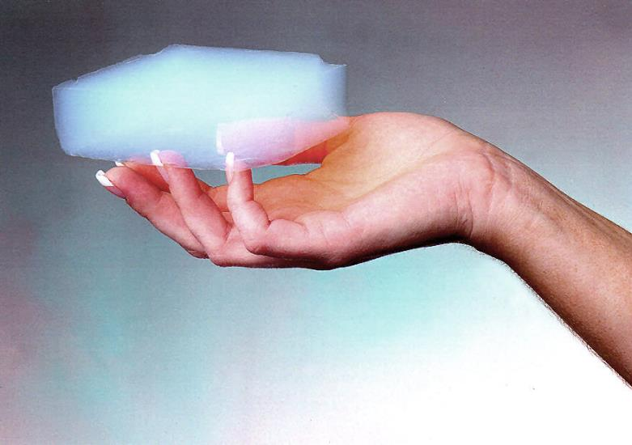
Graphene Aerogel

Slide 83
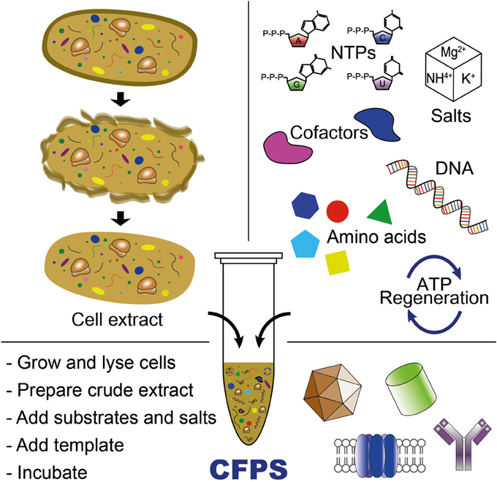
Bioscience - Cell Free Protein Synthesis

Slide 84
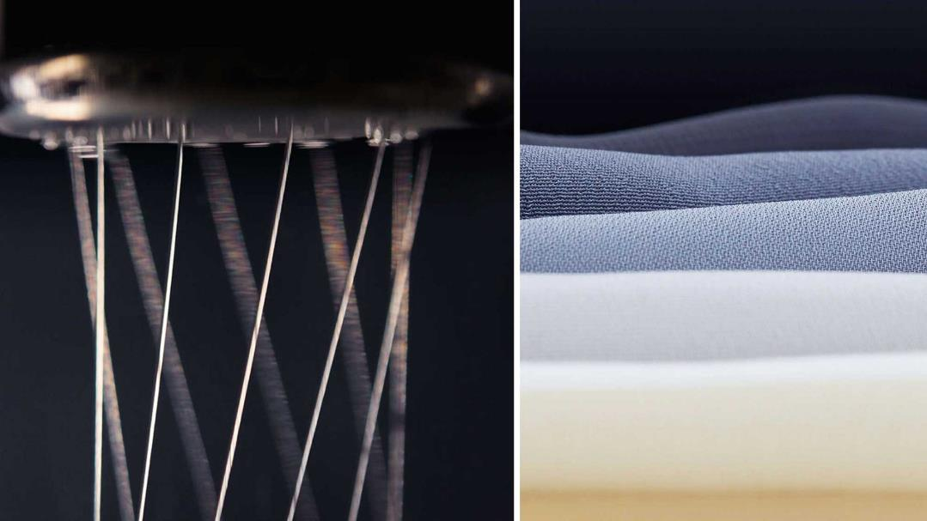
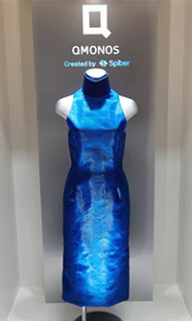
Synthetic Spider Silk

Slide 85

How We Communicate Continues to Evolve

Slide 86




Platforms Continue to Expand
CRM, force.com
Payments,
POs
Alexa, Echo
Web dev, Commerce

Slide 87

Growing Trends that will Continue to Expand
M.G. Siegler, general partner at GV (formerly Google Ventures)
“Artificial intelligence and machine learning are the obvious trends to continue gaining speed into next year. One offshoot of those I’m particularly interested in: I think both vocal and audible computing will continue to get a lot more exciting in 2017. Obviously, products like the Amazon Echo and, more recently, Google Home, have planted the seeds for this. Heading into next year, I suspect products like Apple’s AirPods will expand the trend in different ways.”
http://venturebeat.com/2016/12/26/vc-predictions-for-2017/

Slide 88
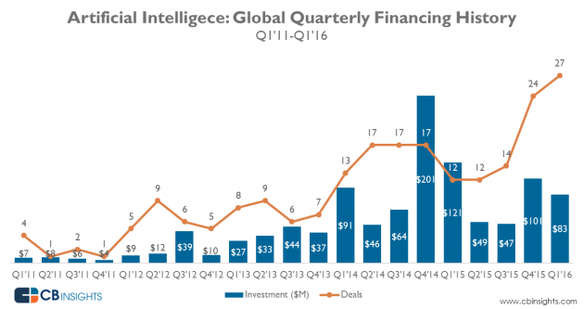

Slide 89
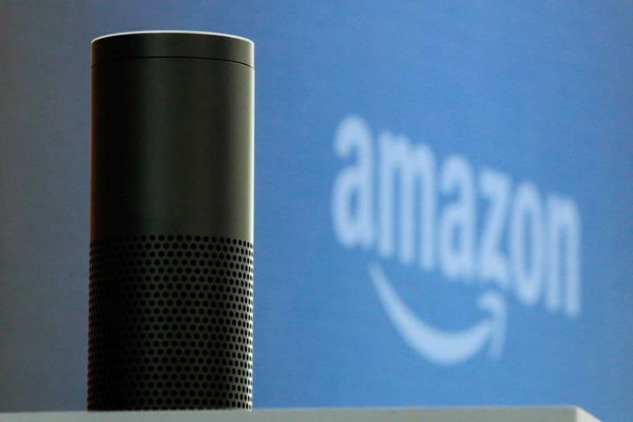
AI & Speech Recognition
7 million homes

Slide 90
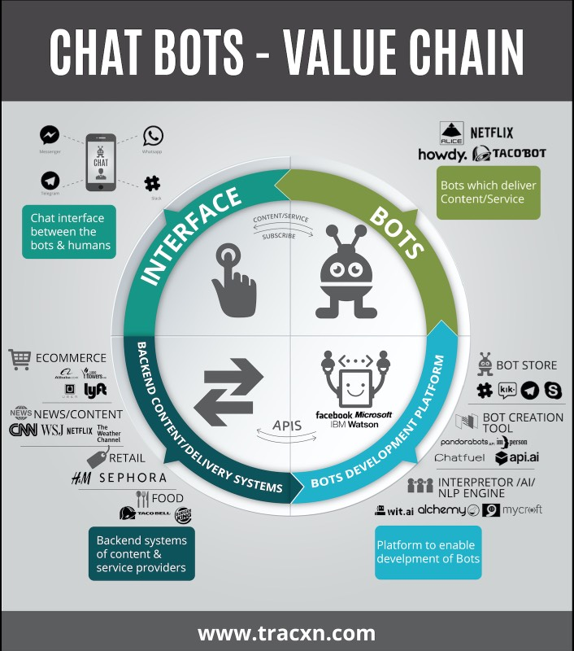
Chat bots

Slide 91
Machine Learning
Bayesian Statistics – Probability Curves
Sentiment Analysis – Recommendation Engines - Natural Language
Factorization Machines (2012)
Solvers
Google TensorFlow – Recurrent & Deep Neural Networks
Stochastic Gradient Point Descent

Slide 92


Slide 93

Global IoT spend in manufacturing to reach $70 billion by 2020
20 billion connected devices by 2020

Slide 94

Connected Clothing

Slide 95

Technology Impact on Commodities

Slide 96


Slide 97


Slide 98

The Future?
How will this impact your business?
How will this impact your customers?
How will this impact you?

Slide 99
What is Machine Learning?
Machine Learning at its most basic is the practice of using algorithms to parse data, learn from it, and then make a determination or prediction about something in the world.” – Nvidia
“Machine learning is the science of getting computers to act without being explicitly programmed.” – Stanford
“Machine learning is based on algorithms that can learn from data without relying on rules-based programming.”- McKinsey & Co.

Slide 100
What is Machine Learning?
“Machine learning algorithms can figure out how to perform important tasks by generalizing from examples.” – University of Washington
“The field of Machine Learning seeks to answer the question “How can we build computer systems that automatically improve with experience, and what are the fundamental laws that govern all learning processes?” – Carnegie Mellon University
Machine learning research is part of research on artificial intelligence, seeking to provide knowledge to computers through data, observations and interacting with the world. That acquired knowledge allows computers to correctly generalize to new settings.- Dr. Yoshua Bengio

Slide 101
What is Machine Learning?
“Machine Learning is the science of getting computers to learn and act like humans do, and improve their learning over time in autonomous fashion, by feeding them data and information in the form of observations and real-world interactions.”

Slide 102
What is Machine Learning?
Machine Learning
Study of algorithms that
improve their performance
at some task
with experience
Optimize a performance criterion using example data or past experience.
Role of Statistics: Inference from a sample
Role of Computer science: Efficient algorithms to
Solve the optimization problem
Representing and evaluating the model for inference

Slide 103

Machine Learning
Notes:
A machine-learning system is trained rather than explicitly programmed. It’s presented with many examples relevant to a task, and it finds statistical structure in these examples that eventually allows the system to come up with rules for automating the task. For instance, if you wished to automate the task of tagging your vacation pictures, you could present a machine-learning system with many examples of pictures already tagged by humans, and the system would learn statistical rules for associating specific pictures to specific tags.

Slide 104

How does Machine learning work?
The way the machine learns is similar to the human being. The core objective of machine learning is the learning and inference.
Learning:
Notes:
The core objective of machine learning is the learning and inference. First of all, the machine learns through the discovery of patterns. This discovery is made thanks to the data. One crucial part of the data scientist is to choose carefully which data to provide to the machine. The list of attributes used to solve a problem is called a feature vector. You can think of a feature vector as a subset of data that is used to tackle a problem.
The machine uses some fancy algorithms to simplify the reality and transform this discovery into a model. Therefore, the learning stage is used to describe the data and summarize it into a model.

Slide 105

How does Machine learning work?
Inferring: When the model is built, it is possible to test how powerful it is on never-seen-before data. The new data are transformed into a features vector, go through the model and give a prediction.

Slide 106

How does Machine Learning work?

Slide 107
Life of Machine Learning Program
Define a question
Collect data
Visualize data
Train algorithm
Test the Algorithm
Collect feedback
Refine the algorithm
Loop 4-7 until the results are satisfying
Use the model to make a prediction

Slide 108
Why “Learn”?
Machine learning is programming computers to optimize a performance criterion using example data or past experience.
There is no need to “learn” to calculate payroll
Learning is used when:
Human expertise does not exist (navigating on Mars),
Humans are unable to explain their expertise (speech recognition)
Solution changes in time (routing on a computer network)
Solution needs to be adapted to particular cases (user biometrics)

Slide 109
What We Talk About When We Talk About“Learning”
Learning general models from a data of particular examples
Data is cheap and abundant (data warehouses, data marts); knowledge is expensive and scarce.
Example in retail: Customer transactions to consumer behavior:
People who bought “Da Vinci Code” also bought “The Five People You Meet in Heaven” (www.amazon.com)
Build a model that is a good and useful approximation to the data.

Slide 110
Data Mining/KDD
Definition := “KDD is the non-trivial process of
identifying valid, novel, potentially useful, and
ultimately understandable patterns in data” (Fayyad)
Applications:
Retail: Market basket analysis, Customer relationship management (CRM)
Finance: Credit scoring, fraud detection
Manufacturing: Optimization, troubleshooting
Medicine: Medical diagnosis
Telecommunications: Quality of service optimization
Bioinformatics: Motifs, alignment
Web mining: Search engines
...

Slide 111
Growth of Machine Learning
Machine learning is preferred approach to
Speech recognition, Natural language processing
Computer vision
Medical outcomes analysis
Robot control
Computational biology
This trend is accelerating
Improved machine learning algorithms
Improved data capture, networking, faster computers
Software too complex to write by hand
New sensors / IO devices
Demand for self-customization to user, environment
It turns out to be difficult to extract knowledge from human experts→failure of expert systems in the 1980’s.

Slide 112
Applications
Association Analysis
Supervised Learning
Classification
Regression/Prediction
Unsupervised Learning
Reinforcement Learning

Slide 113
Learning Associations
Basket analysis:
P (Y | X ) probability that somebody who buys X also buys Y where X and Y are products/services.
Example: P ( chips | beer ) = 0.7
Market-Basket transactions

Slide 114

Classification
Example: Credit scoring
Differentiating between low-risk and high-risk customers from their income and savings
Discriminant: IF income > θ₁ AND savings > θ₂
THEN low-risk ELSE high-risk
Model

Slide 115
Classification: Applications
Aka Pattern recognition
Face recognition: Pose, lighting, occlusion (glasses, beard), make-up, hair style
Character recognition: Different handwriting styles.
Speech recognition: Temporal dependency.
Use of a dictionary or the syntax of the language.
Sensor fusion: Combine multiple modalities; eg, visual (lip image) and acoustic for speech
Medical diagnosis: From symptoms to illnesses
Web Advertizing: Predict if a user clicks on an ad on the Internet.

Slide 116








Face Recognition
Training examples of a person
Test images
AT&T Laboratories, Cambridge UK
http://www.uk.research.att.com/facedatabase.html

Slide 117

Prediction: Regression
Example: Price of a used car
x : car attributes
y : price
y = g (x | θ )
g ( ) model,
θ parameters
y = wx+w₀

Slide 118
Regression Applications
Navigating a car: Angle of the steering wheel (CMU NavLab)
Kinematics of a robot arm
(x,y)
α₁= g₁(x,y)
α₂= g₂(x,y)
α₂
α₁

Slide 119
Supervised Learning: Uses
Example: decision trees tools that create rules
Prediction of future cases: Use the rule to predict the output for future inputs
Knowledge extraction: The rule is easy to understand
Compression: The rule is simpler than the data it explains
Outlier detection: Exceptions that are not covered by the rule, e.g., fraud

Slide 120

Supervised Learning: Uses

Slide 121
Unsupervised Learning
Learning “what normally happens”
No output
Clustering: Grouping similar instances
Other applications: Summarization, Association Analysis
Example applications
Customer segmentation in CRM
Image compression: Color quantization
Bioinformatics: Learning motifs

Slide 122

Unsupervised Learning

Slide 123
Reinforcement Learning
Topics:
Policies: what actions should an agent take in a particular situation
Utility estimation: how good is a state (→used by policy)
No supervised output but delayed reward
Credit assignment problem (what was responsible for the outcome)
Applications:
Game playing
Robot in a maze
Multiple agents, partial observability, ...

Slide 124

Reinforcement Learning

Slide 125

Machine Learning Algorithms

